Slide 1
JAVA APPLICATION DEBUGGING
Instructor:

Slide 2
Agenda
What is debugging?
Breakpoints
Starting the Debugger
Debug Perspective
Controlling the program execution
Evaluating variables in the debugger
Changing variable assignments in the debugger
Notes:
Using output display too: System.out.println

Slide 3

Overview
Debugging allows you to run a program interactively while watching the source code and the variables during the execution.
A breakpoint in the source code specifies where the execution of the program should stop during debugging. Once the program is stopped you can investigate variables, change their content, etc.
To stop the execution, if a field is read or modified, you can specify watchpoints.
Breakpoints and watchpoints are sometimes called stop points.

Slide 4
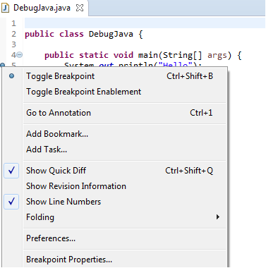
Breakpoints
A breakpoint is a signal that tells the debugger to temporarily suspend execution of your program at a certain point in the code.
Basically, there are 3 ways to add breakpoints to the program:
Right-click on the marker bar (vertical ruler) corresponding to the line and select Toggle Breakpoint (shown in the below screenshot)
Press Ctrl+Shift+B on the necessary line while in the editor
Double-click on the marker bar (vertical ruler) corresponding to the necessary line.

Slide 5
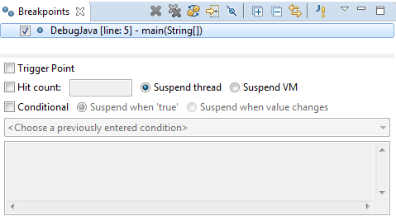

Breakpoints
The Breakpoints view allows you to delete and deactivate Breakpoints and modify their properties.
All breakpoints can be enabled/disabled using Skip All Breakpoints. If you press it again, your breakpoints are reactivated. Breakpoints can also be imported/exported to and from a workspace.

Slide 6
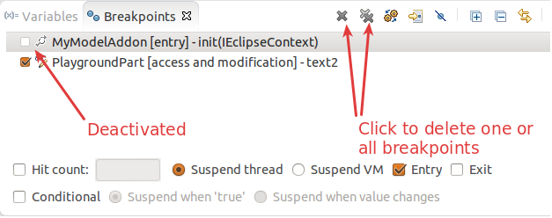
Breakpoints
To delete it you can use the corresponding buttons in the view toolbar. These options are depicted in the following screenshot.

Slide 7
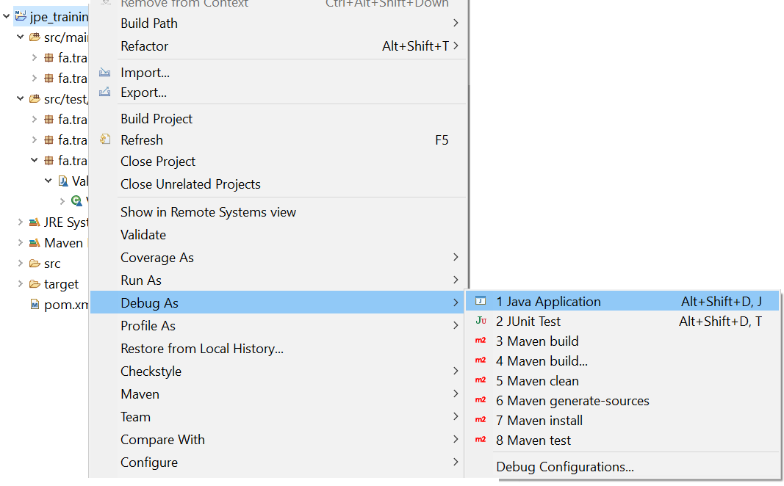
Starting the Debugger
A Java program can be debugged simply by right clicking on the Java editor class file from Package explorer. Select Debug As → Java Application or use the shortcut Alt + Shift + D, J instead.

Slide 8
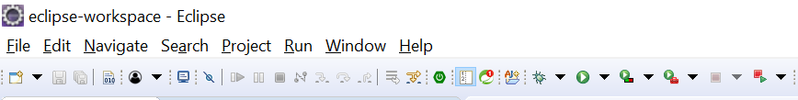
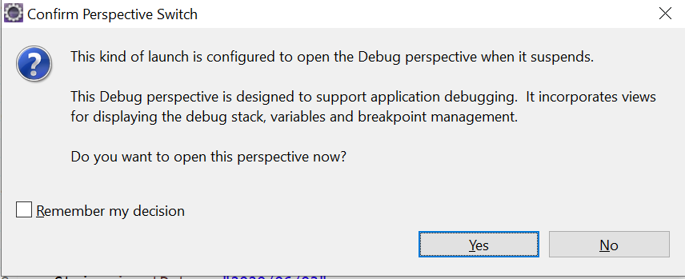
Starting the Debugger
If you started an application once via the context menu, you can use the created launch configuration again via the Debug button in the Eclipse toolbar.
Confirm Perspective Switch:

Slide 9
Debug Perspective
The debug perspective offers additional views that can be used to troubleshoot an application like Breakpoints, Variables, Debug, Console etc.
When a Java program is started in the debug mode, users are prompted to switch to the debug perspective.
Debug view: Visualizes call stack and provides operations on that.
Breakpoints view: Shows all the breakpoints.
Variables/Expression view: Shows the declared variables and their values. Press Ctrl+Shift+d or Ctrl+Shift+i on a selected variable or expression to show its value. You can also add a permanent watch on an expression/variable that will then be shown in the Expressions view when debugging is on.
Display view: Allows to Inspect the value of a variable, expression or selected text during debugging.
Console view: Program output is shown here.

Slide 10
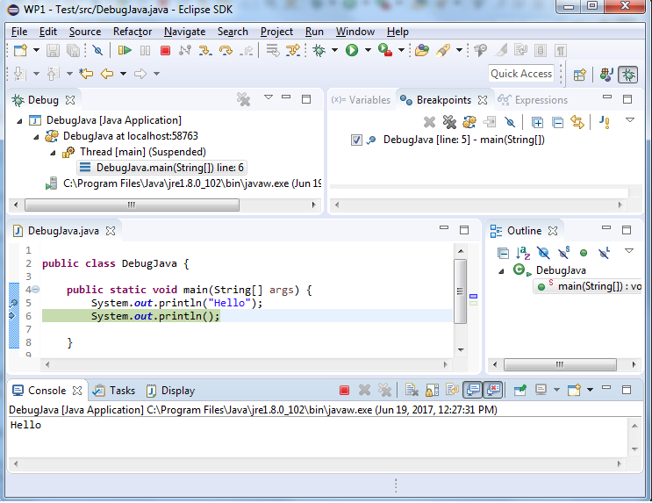
Debug Perspective
Debug Perspective view:

Slide 11

Controlling the program execution
Eclipse provides buttons in the toolbar for controlling the execution of the program you are debugging:
You can use allow use shortcut key to step through your coding. The meaning of these keys is explained in the following table.
Key | Description
F5 | Executes the currently selected line and goes to the next line in your program. If the selected line is a method call the debugger steps into the associated code.
F6 | F6 steps over the call, i.e. it executes a method without stepping into it in the debugger.
F7 | F7 steps out to the caller of the currently executed method. This finishes the execution of the current method and returns to the caller of this method.
F8 | F8 tells the Eclipse debugger to resume the execution of the program code until is reaches the next breakpoint or watchpoint.

Slide 12
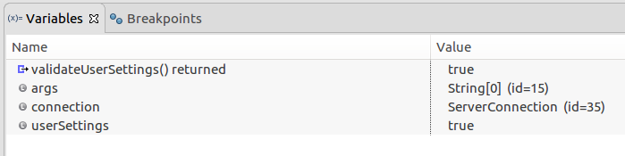
Evaluating variables in the debugger
The Variables view displays fields and local variables from the current executing stack. Please note you need to run the debugger to see the variables in this view.

Slide 13
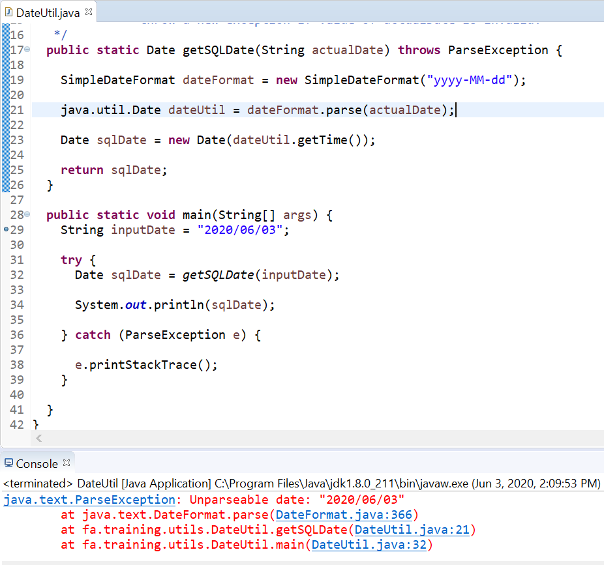
Evaluating variables in the debugger
Given the following methods, run the main method you will face with an exception:

Slide 14
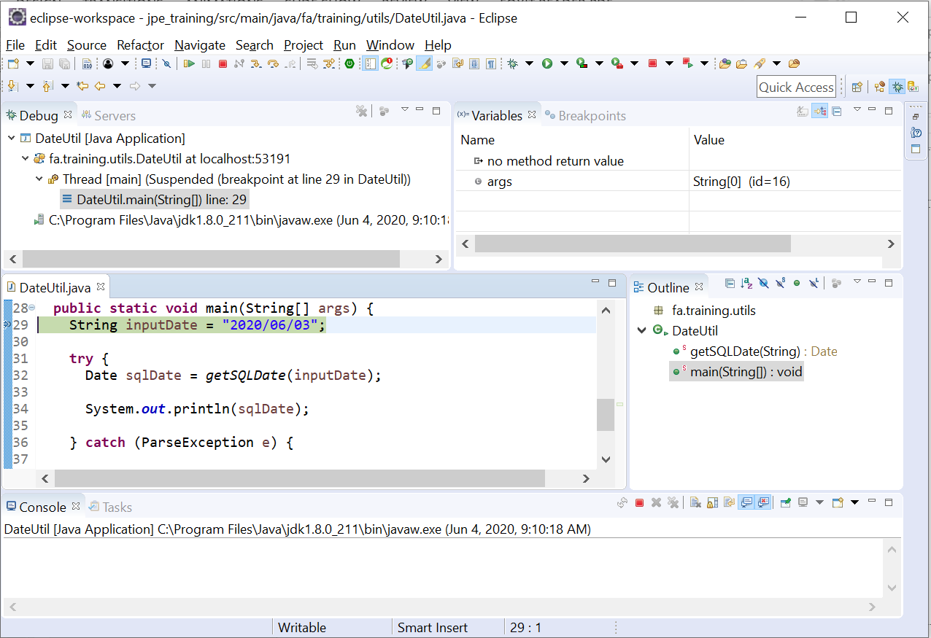
Evaluating variables in the debugger
Debug this program, the Perspective mode as follows screen, a Breakpoints at line of code 29:

Slide 15
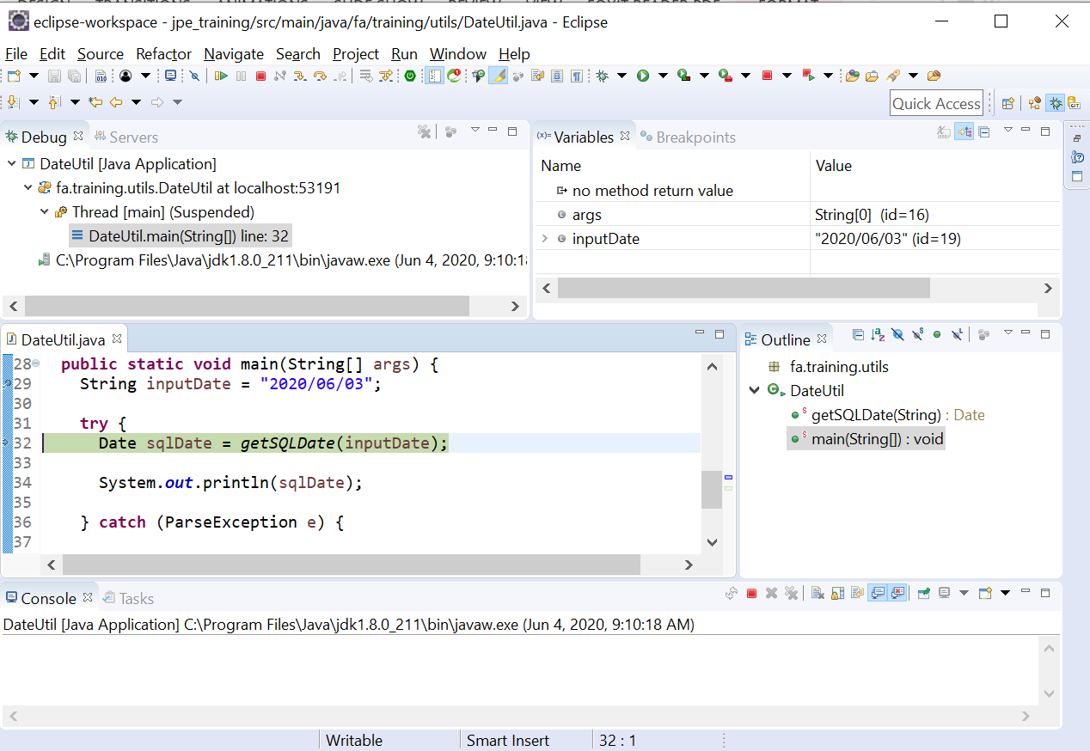
Evaluating variables in the debugger
Press F6 to over:

Slide 16
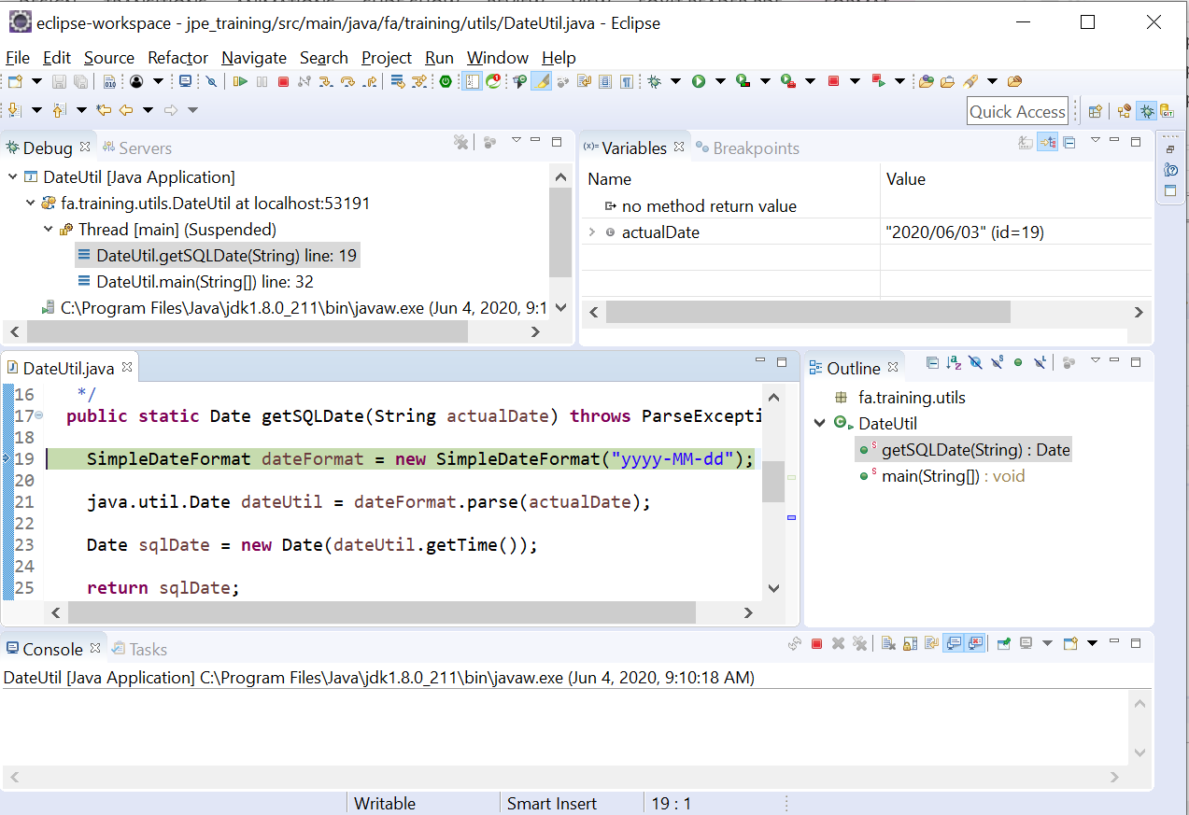
Evaluating variables in the debugger
Press F5 to into the getSQLDate() method, in Variables tab, value of actualDate is "2020/06/03":

Slide 17
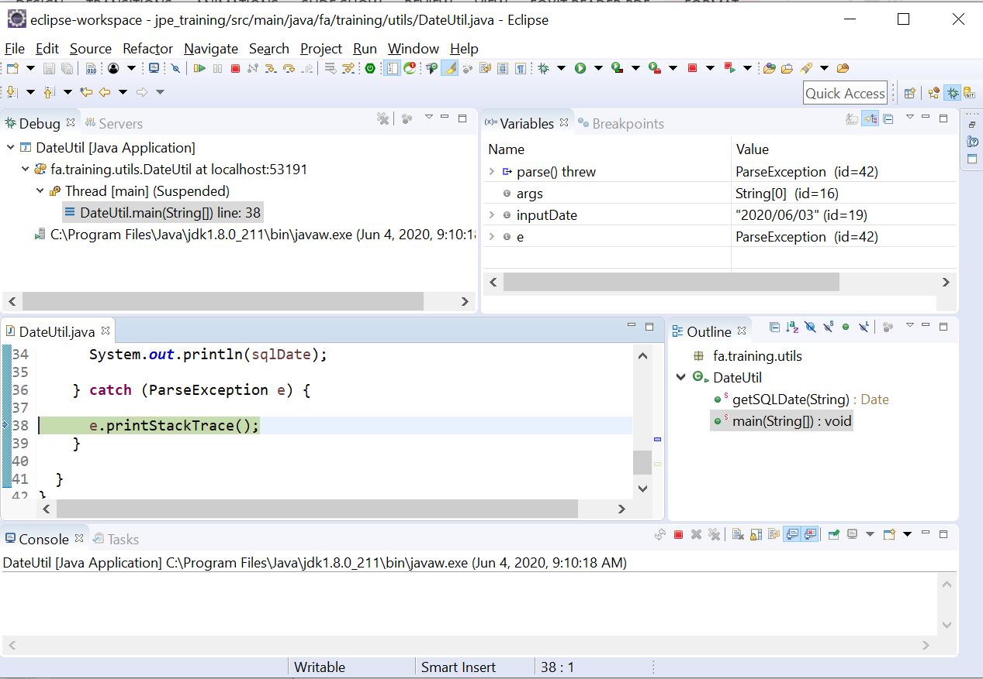
Evaluating variables in the debugger
Press F6 to over, an exception be thrown as follows screen:

Slide 18
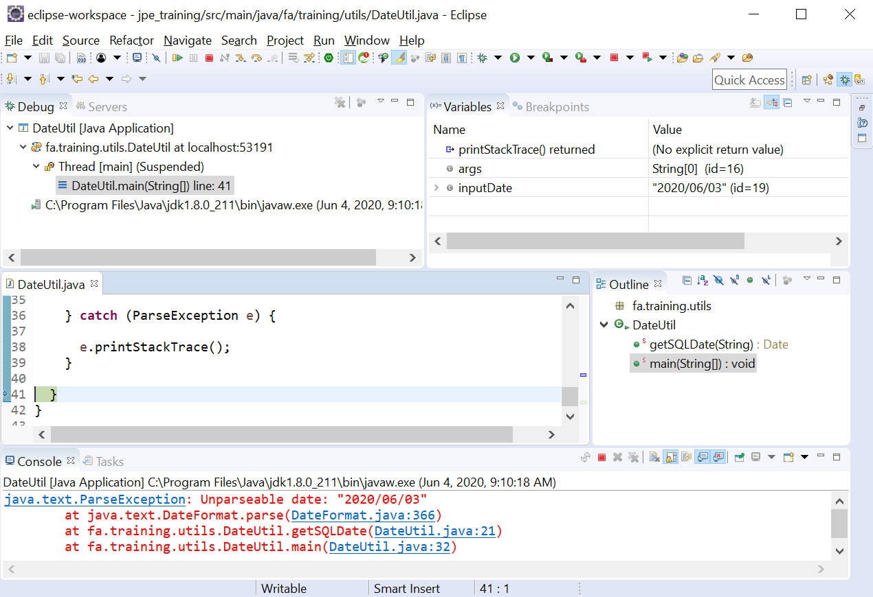
Evaluating variables in the debugger
Unparseable date "2020/06/03“ at java.text.DateFormat.parse (DateFormat.java:366). Error at line of code DataUtil.java: 21.
Therefore, to resolve this problem, you must change format of inputDate to "2020-06-03". Following the pattern be defined in SimpleDateFormat:
SimpleDateFormat dateFormat = new SimpleDateFormat("yyyy-MM-dd");

Slide 19
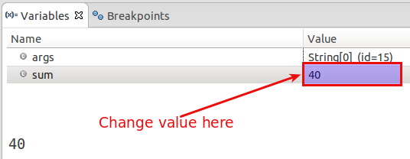
Changing variable assignments in the debugger
The Variables view allows you to change the values assigned to your variable at runtime. This is depicted in the following screenshot.

Slide 20
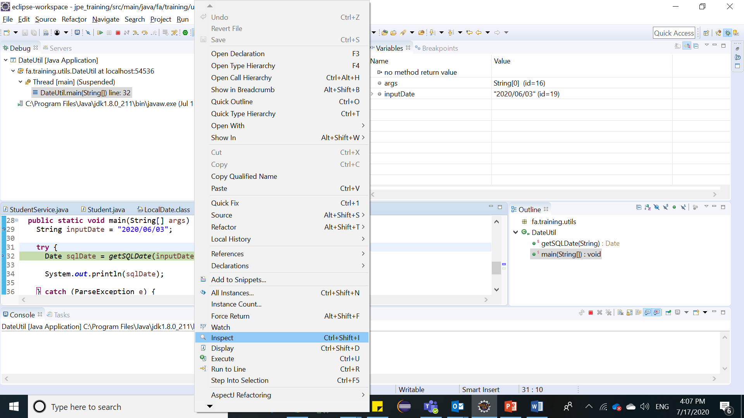
Inspecting Values
If we need to inspect the value of a Java expression or statement, we can select the particular expression in the editor, right-click, and Inspect, as shown below.
A handy shortcut is to hit Ctrl+Shift+I on the expression to see the value:

Slide 21
Debug Shell
In the context of the debugging session, we can write and run custom code to evaluate possibilities. This is done in the Debug Shell.
If we need to cross-check the correctness of the sqrt functionality, we could do it in the Debug Shell. On the code, Right-click -> Inspect to see the value.
For class:
public class PerfectSquareCounter {
static int evenPerfectSquareNumbers = 0;
public static void main(String[] args) {
int n = 100;
System.out.println("Total Perfecr Squares: "
+ calculateCount(n));
System.out.println("Even Perfect Squares: "
+ evenPerfectSquareNumbers);
}
public static evenPerfecint calculateCount(int n) {
int perfectSquareCount = 0;
for (int number = 0; number < n; number++) {
if (isPerfectSquare(number)) {
perfectSquareCount++;
if (number % 2 == 0) {
evenPerfectSquareNumbers++;
}
}
}
return perfectSquareCount;
}
private static boolean isPerfectSquare(int number) {
double sqrt = Math.sqrt(number);
return sqrt - Math.floor(sqrt) == 0;
}
}

Slide 22
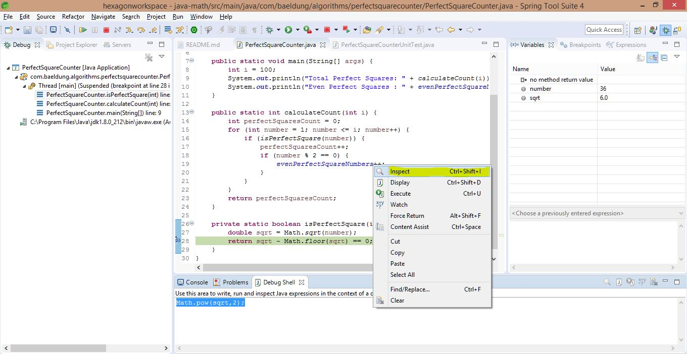
Debug Shell

Slide 23
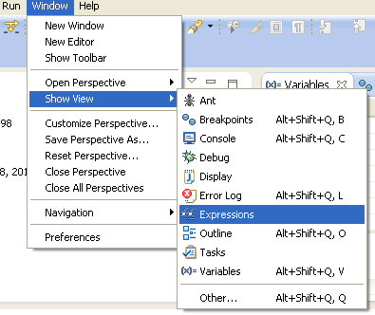


Expression watcher

Slide 24
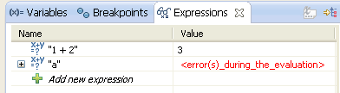
Customized: out of context

Slide 25
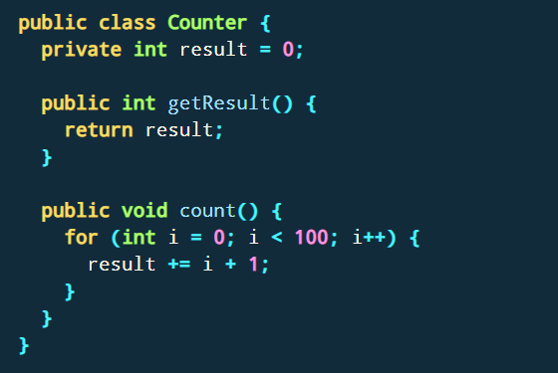
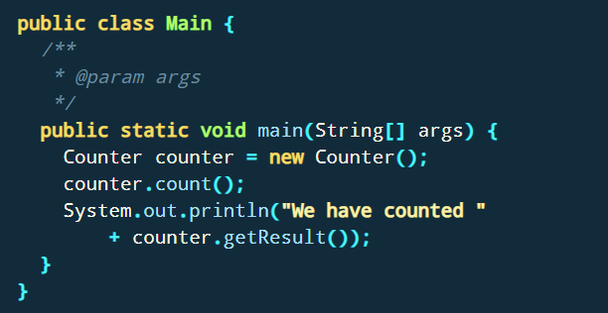
Exersice: Create Project for debugging
To practice debugging create a new Java project called jpe_exersice. Also create the package fa.training.unit11 and create the following classes.
Set a breakpoint in the Counter class. Debug your program and follow the execution of the count method.
Define a Detailed Formatter for your Counter which uses the getResult method. Debug your program again and verify that your new formatter is used.
Delete your breakpoint and add a breakpoint for classloading. Debug your program again and verify that the debugger stops when your class is loaded.

Slide 26
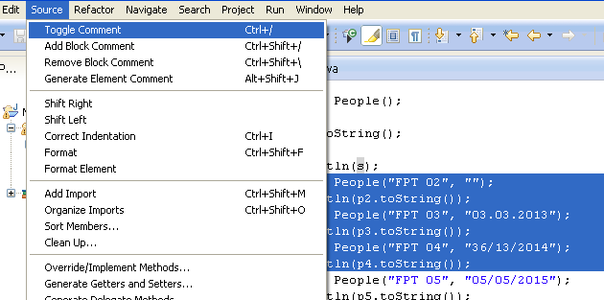
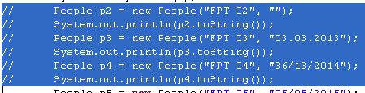
Deactivate/Reactivate
Notes:
Attention, some Eclipse version has Ctrl+7 in place of Ctrl+/ but the last one is still OK

Slide 27
Lesson Summary
What is debugging?
Breakpoints
Starting the Debugger
Debug Perspective
Controlling the program execution
Evaluating variables in the debugger
Changing variable assignments in the debugger
Notes:
Tìm hiểu thêm về Advance Debugging: https://www.vogella.com/tutorials/EclipseDebugging/article.html

Slide 28

Thank you

